Slide 1

Credit Card Data Analysis
Members:
RAYA HARISH (WX2EE50531)
ANANNYA SINGH (3NJZ6RGL7W)
PAVAN JACOB ABRAHAM (0VJK2O7W3P)
ANMOL GUPTA (6Q2YCTLSMW)
Presented by:
GROUP 2

Slide 2
The project aims to apply core statistical and exploratory data analysis (EDA) techniques to a credit card dataset, simulating real-world data science scenarios. It involves detailed data cleaning, analysis, and visualization to extract valuable business insights.
The outcome will be a comprehensive report guiding business decisions based on statistical findings and visualizations.
Problem Statement

Slide 3
V1: Customer ID
V2: If a customer has bounced in first EMI
V3: Number of times bounced in recent 12 months
V4: Maximum MOB (Month of business with TVS Credit)
V5: Number of times bounced while repaying the loan
V6: EMI
V7: Loan Amount
V8: Tenure
V9: Dealer codes from where customer has purchased the Two wheeler
V10: Product code of Two wheeler
V11: No of advance EMI paid
V12: Rate of interest
V13: Gender (Male/Female)
V14: Employment type
V15: Resident type of customer
V16: Date of birth
V17: Age at which customer has taken the loan
V18: Number of loans
V19: Number of secured loans
V20: Number of unsecured loans
Data Description

Slide 4

Data Cleaning
and
Problem Solving Steps

Slide 5
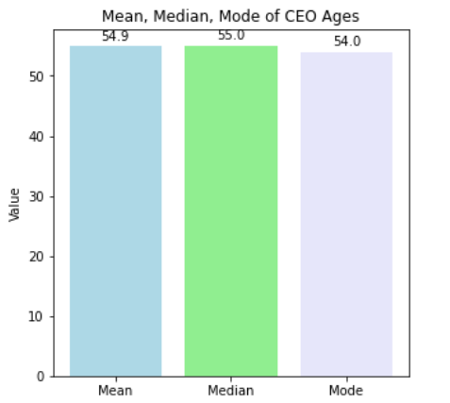
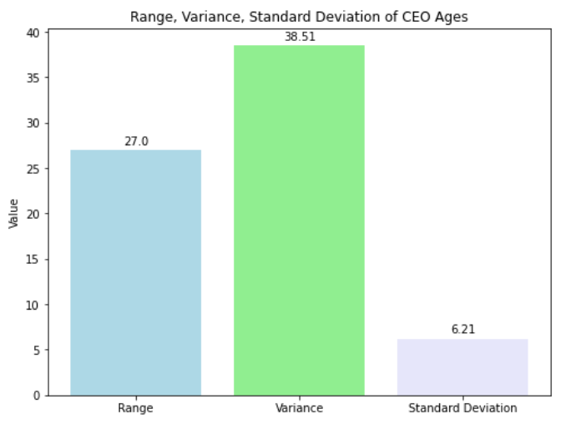
Compute the mean, median and the mode of the data, Compute the range , variance and standard deviation of CEO ages
1.approximately Data is Normally Distributed (Mean = Median = Mod
2.Range = 27 years, Variance = 38.51 years, Standard deviation = 6.21 years, indicating notable dispersion in ages within the dataset.

Slide 6
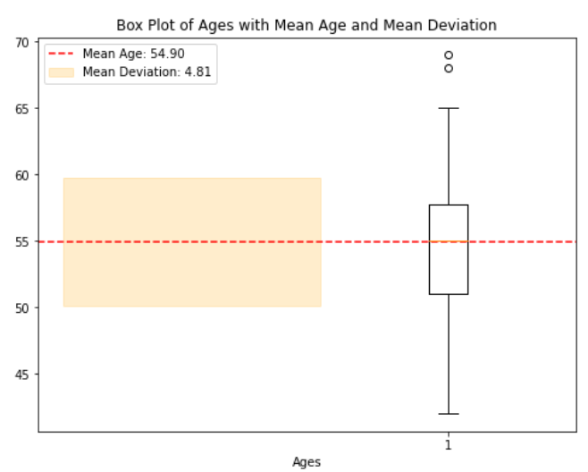
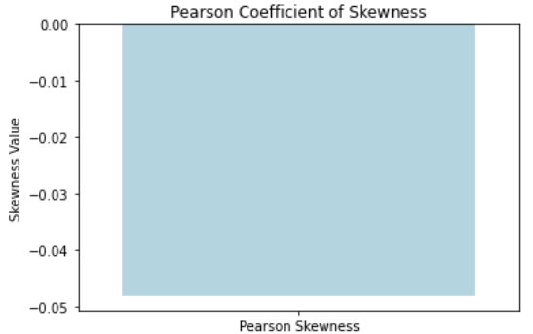
Find the mean deviation for the data , Calculate the Pearson coefficient of skewness and comment on the skewness of the data
1.The mean deviation is 4.814 indicates a relatively low variability in CEO ages around the mean age in the dataset.
2.the data is negatively skewed with -0.0483

Slide 7
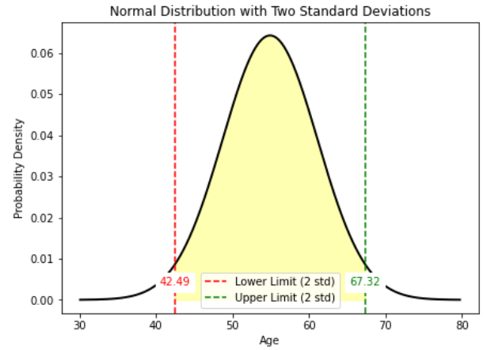
Count the number of data values that fall within two standard
deviations of the mean. Compare this with the answer from
Chebyshev’s Theorem.
1.Number of data values in Chebyshev's rule within two standard deviations is: 32
2.Proportion of data within two standard deviations for Chebyshev's rule: 75%

Slide 8
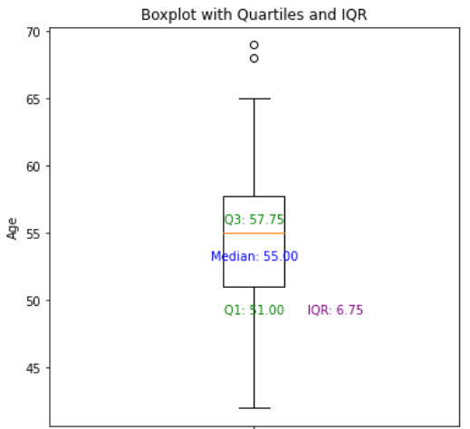
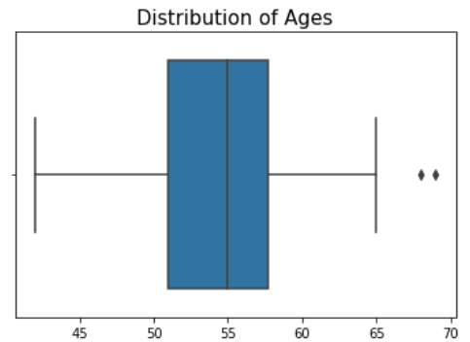
Find the three quartiles and the interquartile range (IQR), Are there any outliers in the data set, draw a boxplot of the dataset to confirm .
1.The data is clustered around median, with less variability.
2.Ages of CEO’s is approximately normally distributed with few outliers

Slide 9
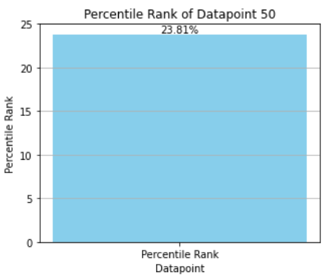
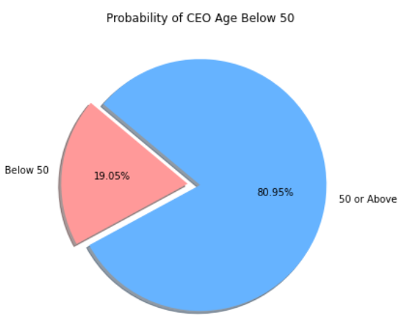
Find the percentile rank of the datapoint 50, What is the probability that a person becoming a CEO is below 50 years of age
1.About 23.81% of the CEOs in the dataset were younger than or equal to 50 years old.
2.The probability that a person becoming a CEO is below 50 years of age is 19.05%.

Slide 10
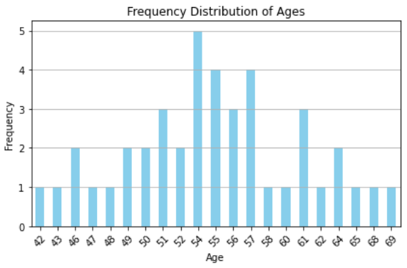
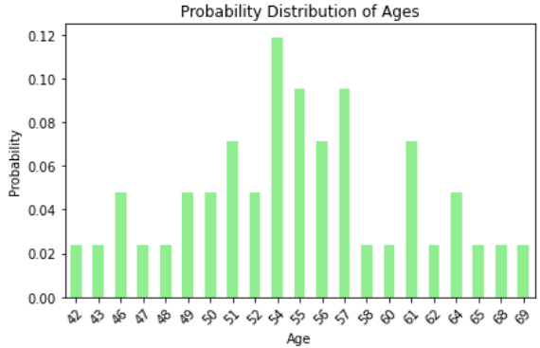
Create a frequency distribution for the data and visualize it appropriately, Create a probability distribution of the data and visualize it appropriately
1.Data is normal distributed, clustered around mean, less frequency at the extremes
2.Probability distribution of data where age 54 has the maximum probability of 0.12.

Slide 11
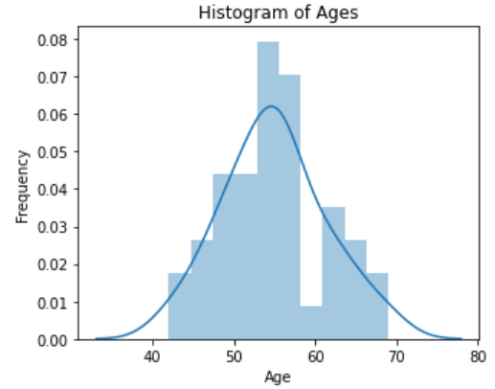
Does the shape of the age distribution dataset follow the Central Limit Theorem? Create sampling distributions of the mean age using sample sizes of 10, 15, 20, 25, and 30, and compare them to observe the effect on the distribution of means.
Data is approximately normally distributed

Slide 12
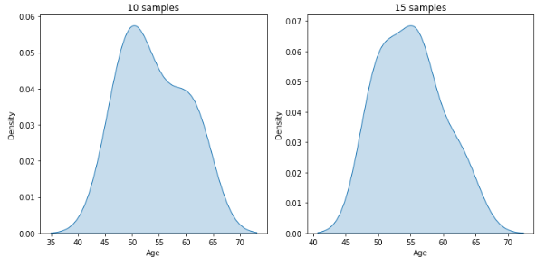
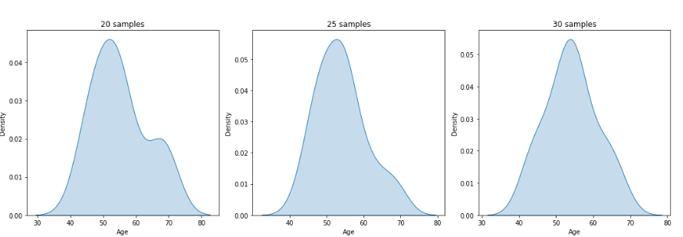
Increasing sample size leads to sampling distributions of the mean becoming more normally distributed, confirming the Central Limit Theorem.

Slide 13
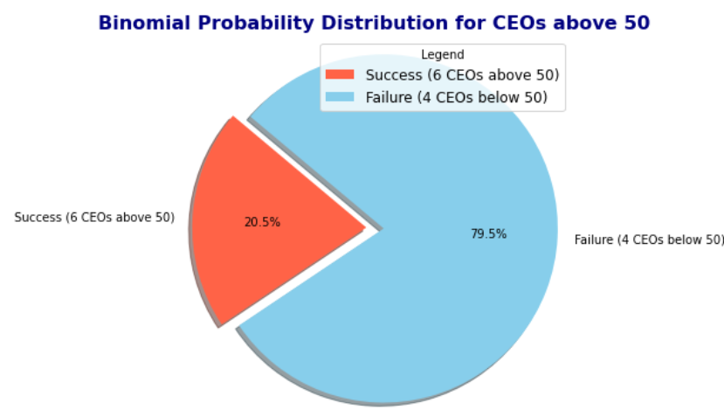
Treat this dataset as a binomial distribution where p is the probability that a person becomes a CEO above 50 years age. What is the probability that out of a random sample of 10 CEOs of Fortune 500 companies exactly 6 are above 50 years of age
There's a 20% chance that exactly
6 out of 10 randomly selected Fortune 500 CEOs are over 50, based on a binomial distribution.

Slide 14
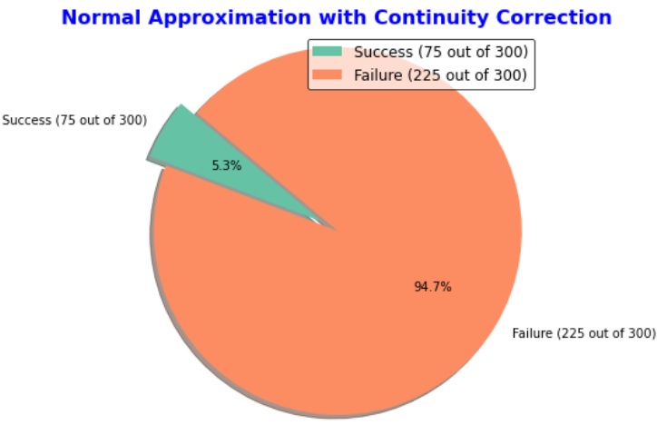
A study claims that 25% of all Fortune 500 companies becoming a CEO are above 60 years of age. Using the Normal approximation of a Binomial distribution, find the probability that in a random sample of 300 Fortune 500 companies exactly 75 CEOs will be above 50 years of age
The 0.053 probability indicates the chance that exactly 75 out of 300 Fortune 500 CEOs are over 50, using a normal approximation of the binomial distribution.

Slide 15
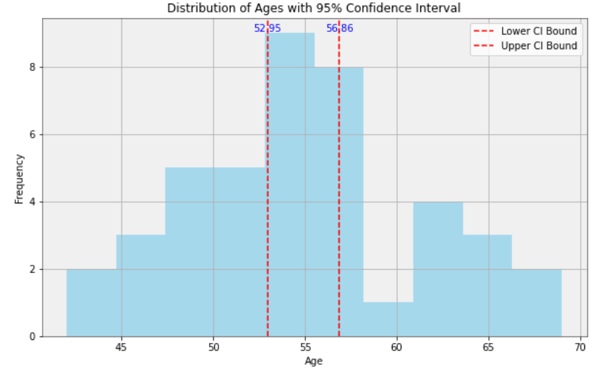
Compute a 95% Confidence Interval for the true mean age of the population of CEOs for the given dataset using appropriate distribution
The histogram shows a distribution with a 95% confidence interval for the mean ranging from approximately 52.95 to 56.86.

Slide 16
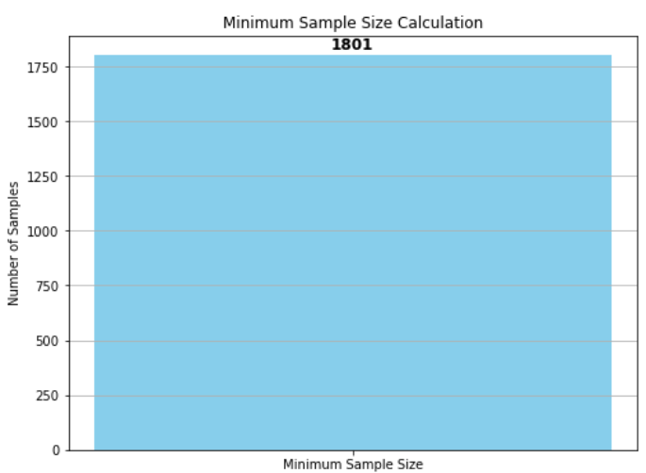
A data scientist wants to estimate with 95% confidence the proportion of CEOs of Fortune 500 companies are above 60 years in the population. Another recent study showed that 25% of CEOs interviewed were above 60. The data scientist wants to be accurate within 2% of the true proportion. Find the minimum sample size necessary.
the minimum sample size is 1801.

Slide 17
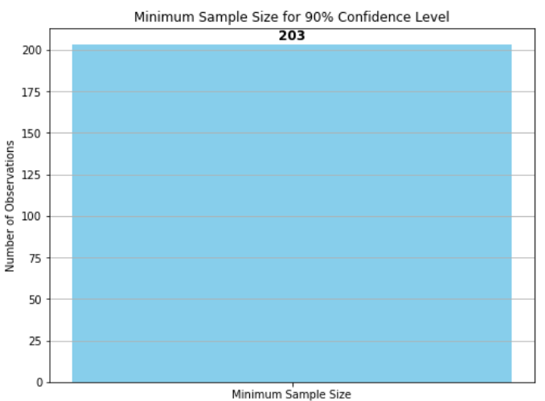
The same data scientist wants to estimate the true proportion of CEOs ascending to the post and above 60 years. She wants to be 90% confident and accurate within 5% of true proportion. Find the minimum sample size necessary.
the minimum sample size is 203.

Slide 18
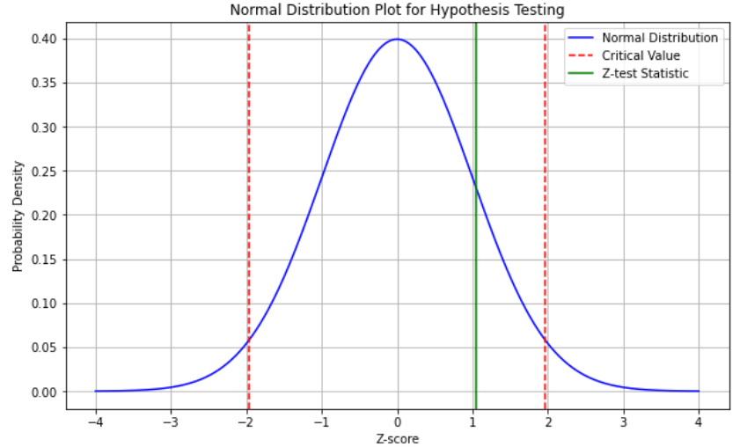
A researcher claims that currently 25% of all CEOS are above 60 years . Test his claim with an alpha =0.05 if out of a random sample of 30 CEOs only 10 are above 60 years.
The claim 25% of all CEO’s are above 60 years is True, in graph the z score falls inside the acceptance region.

Slide 19
What are your hypotheses?
Null Hypothesis (H0): The average CEO age of UK is not significantly different from the average CEO age of America.
Alternative Hypothesis (H1): The average CEO age of UK is significantly older than the average CEO age of America.
What significance level will you use?
α=0.05
What statistical test will you use?
Two-Sample t-Test: Used to compare the means of two independent groups.
Assumptions:
Independence: The samples from the two groups must be independent.
Normality: Data should be approximately normally distributed within each group.
Equal Variances: Ideally, the variances should be equal. If not, use Welch's t-test.

Slide 20
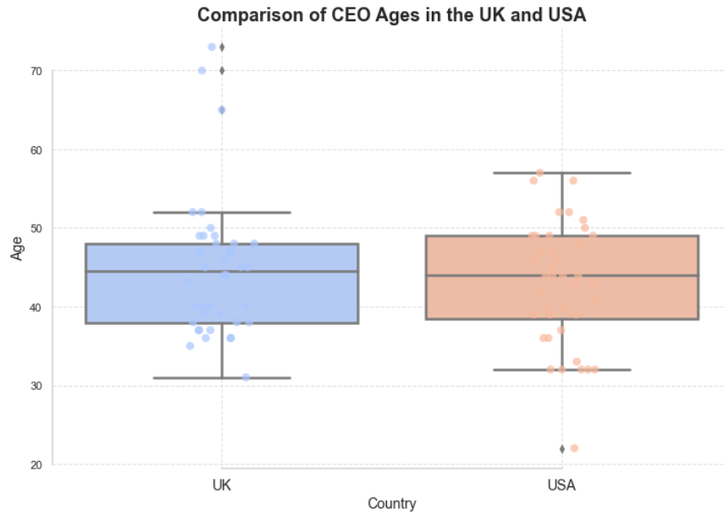
What are the test results? (Assume s1 = 8.8 and s2= 7.8.) hypotheses? What is your decision?
The UK sample mean is 44.75 and the USA sample mean is 42.875. A t-test
(t = 1.008, df = 76.89, p = 0.316) shows no statistically significant difference between the two means.

Slide 21
What can you conclude?
Based on a p-value of 0.3164 (>0.05), we fail to reject the null hypothesis, suggesting no significant difference in CEO ages between the UK and USA. This leads to the conclusion that the age profiles of CEOs in both countries are similar based on the given data.
Do you feel that using the data given really answers the original question asked
The analysis provides valuable insights but may not be fully generalizable due to the limited sample size of 40 CEO ages from each country. Further research with larger and more diverse samples would enhance the validity and generalizability of the findings regarding CEO age demographics between the UK and the USA.
What other data might be used to answer the question
Examining historical trends, company size influences, cultural perceptions, industry-specific trends, and socioeconomic factors can provide a comprehensive analysis of CEO age demographics between the UK and USA, offering insights into changing preferences and underlying drivers.

Slide 22
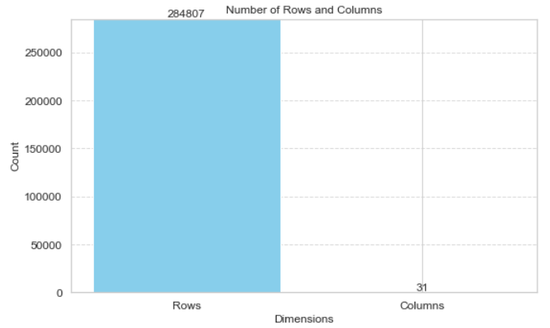
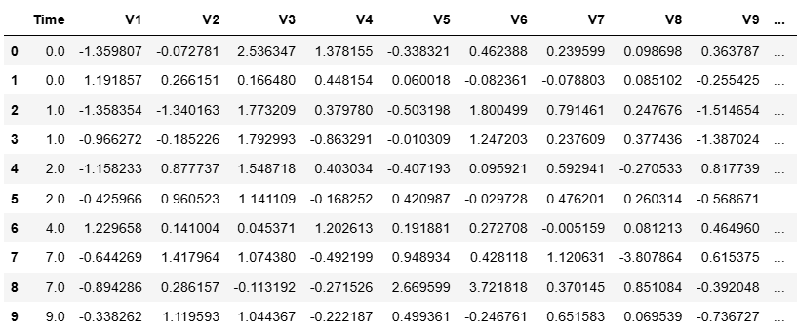
Import the dataset and view the first 10 rows of it, Display shape of the dataset
The Number of rows in dataset are : 284807
The Number of columns in dataset are : 31

Slide 23
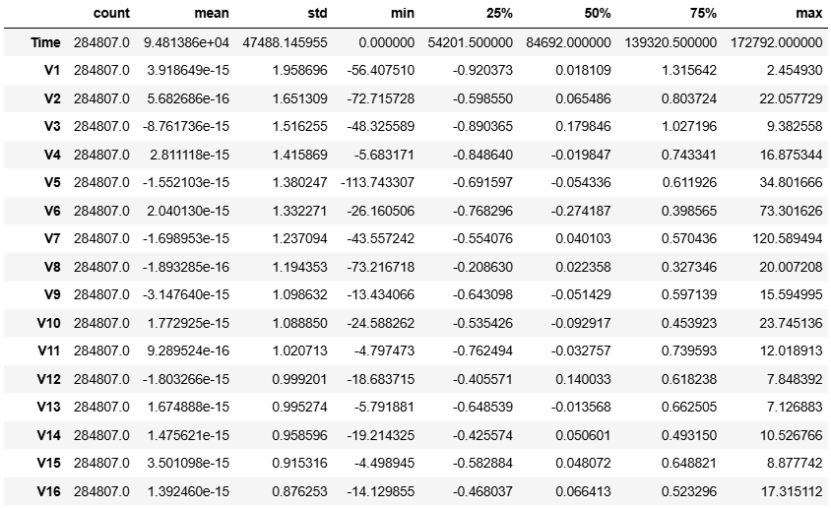
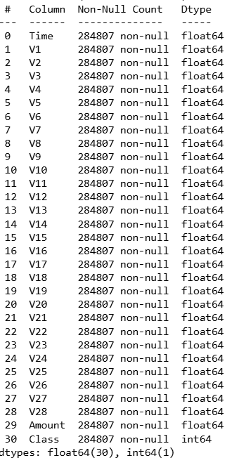
Check for the missing values. Display number of missing values per column Check the datatype, number of non-null values and name of each variable in the dataset, Check if there are any non-real characters in the dataset. Check the descriptive statistics of the dataset
1.No missing values for all columns, data types are appropriate, Almost all the columns are non-null columns
2.No columns with non-real characters or non-numeric data types found in the dataset.

Slide 24
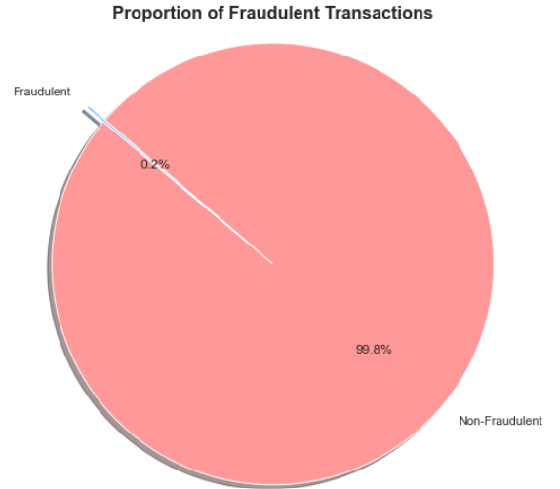
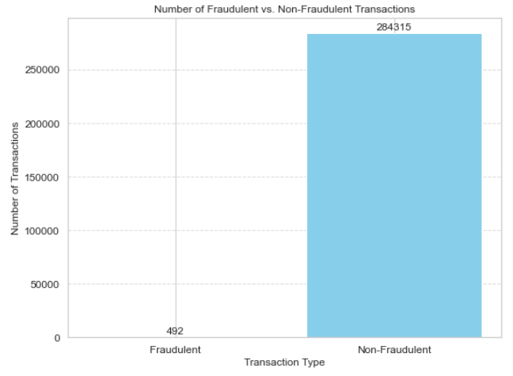
Check the number of fraudulent transactions in the dataset and visualize using pie chart and bar plot.
From the bar plot and pie chart, we conclude that 0.2% of the data, which equates to 492 data points, represents fraudulent transactions.

Slide 25
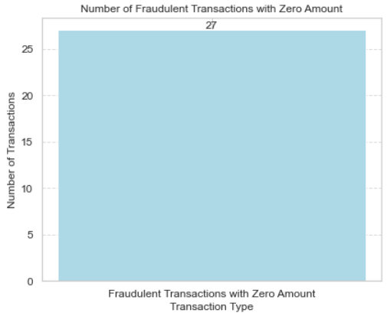
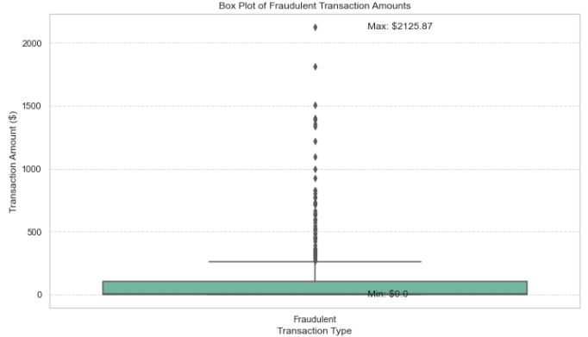
Check the maximum and minimum fraudulent amount. Check the number of transactions where the transaction amount is zero and consider as a fraud transaction.
1.The maximum fraudulent amount is $2125.8, the minimum fraudulent amount is $0.0 2.There are 27 fraudulent transactions with a zero amount.

Slide 26
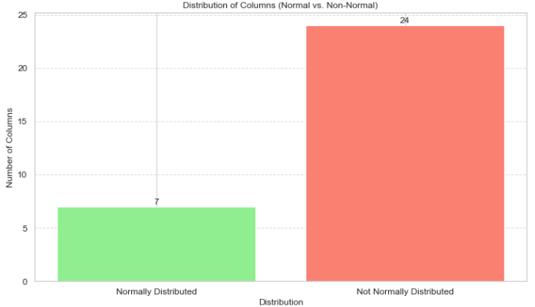
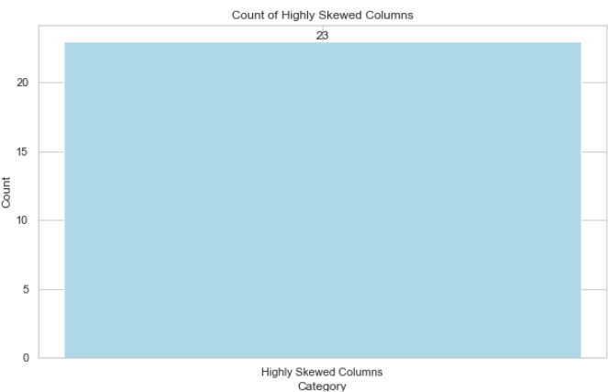
Check the distribution of columns. List down columns that are normally distributed. List down columns that are not normally distributed. List down columns that are highly skewed
1.The dataset has 7 normally distributed columns, 24 non-normally distributed columns 2.23 highly skewed columns.

Slide 27
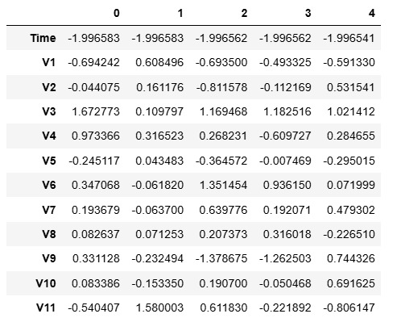
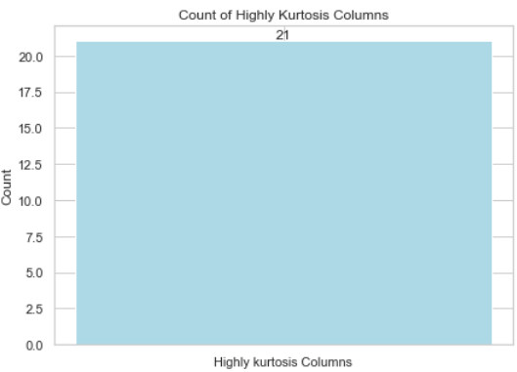
With the help of a standard scaler, normalize the respective column distribution. List down columns that have high kurtosis
The dataset has 21 highly Kurtosis columns.

Slide 28
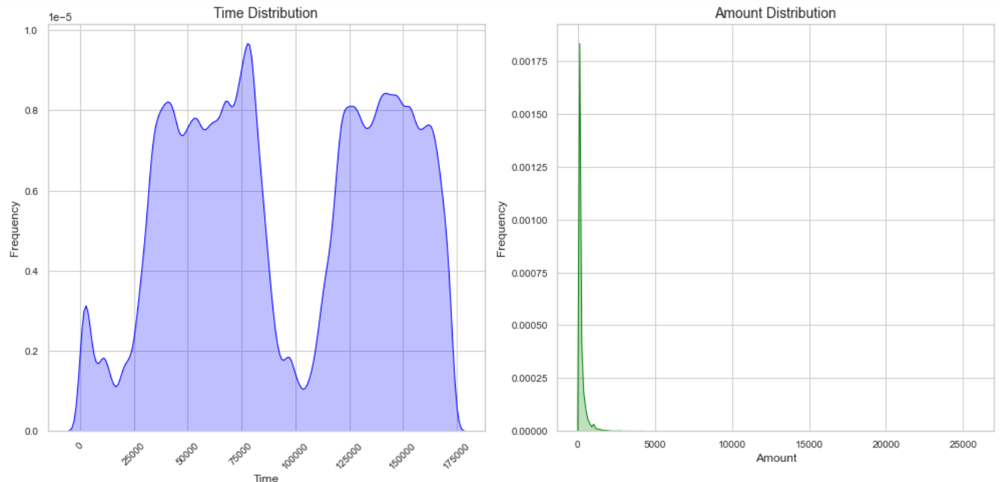
What is the distribution of Time and Amount columns in the dataset
The Time column shows a multimodal distribution, while the Amount column exhibits a highly skewed distribution.

Slide 29
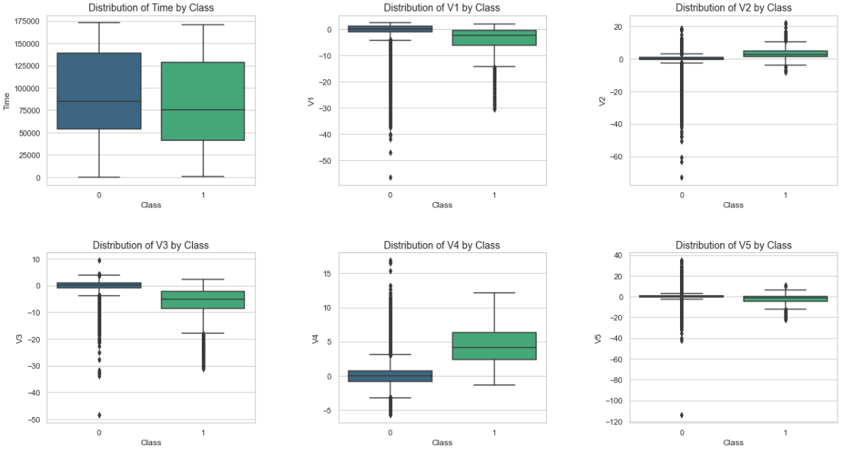
Find the distribution of all variables with respect to the outcome ‘Class’ variable.
Time and amount show good variation across classes, and v1 to v28 have significant outliers, indicating potential predictive power.

Slide 30
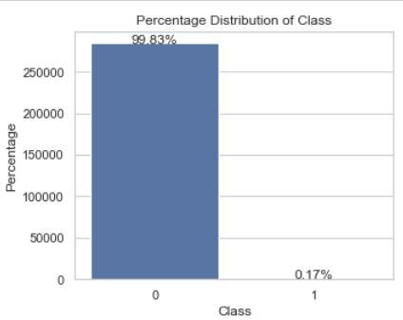
Create a count plot for the outcome class in seaborn using percentage instead of count for each bar
1.Class 0 heavily dominates with a 99% prevalence (heavily skewed towards class 0) , leaving only 1% for class 1.

Slide 31
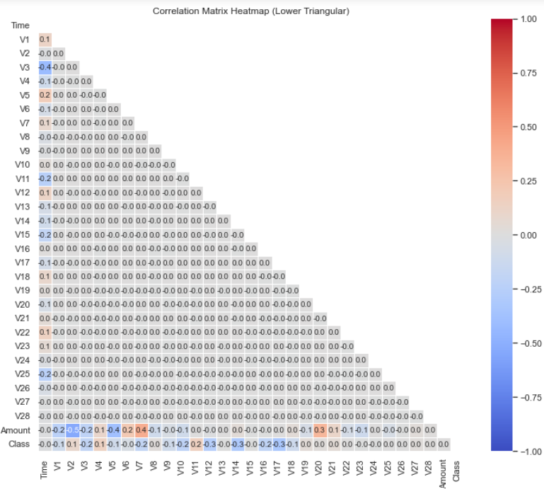
Plot a heatmap for correlation matrix for the given dataset.
No columns show high positive or negative correlation; some have moderate correlation.

Slide 32
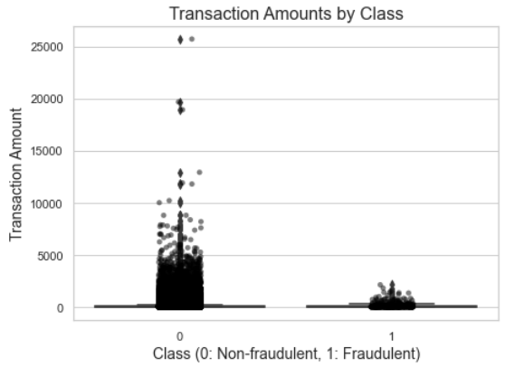
With the help of hypothesis testing check whether fraudulent transactions of higher value than normal transactions
Null Hypothesis (H0): There is no difference in mean transaction amounts between fraudulent and non-fraudulent transactions.
Alternative Hypothesis (H1): Fraudulent transactions have a higher mean transaction amount than non-fraudulent transactions.
P_value for whitney : 0.9999
Failed to Reject Null Hypothesis : There is no Higher values in fraudulent transactions.

Slide 33
Split the dataset randomly into train and test datasets. Use a train -testratio of 70:30 ratio.
The dataset was randomly split into training and testing sets with a ratio of 70:30, resulting in respective shapes of (139554, 30) and (59810, 30) for the training and testing sets.
What is the shape and size of the dataset? Which columns are highly skewed? Which columns are highly Kurtosis driven? Which columns have Wrong data type? What columns seem to have outliers based on min, max and percentile values, IQR range along with the standard deviation and mean absolute deviation
1. The dataset has a shape of (284,807, 31).
2. The dataset size is 8,829,017.
3. The columns that exhibit high skewness are Amount, V28, V21, V7, V6, V10, V16, V27, V14, V20, V3, V12, V5, V1, V17, V2, V23, and V8.
4. The columns that exhibit high kurtosis are V28, Amount, V23, V7, V20, V27, V8, V21, V5, V2, V17, V6, V1, V10, V3, V14, V12, V16, V25, and V9.
5. The Time column should be in the time data type and class should be in object.
6. Almost all columns from V1-V28, Amount and Time has outliers except class column.

Slide 34
What columns have missing values, What columns have high amount of zero and make sure that these zeroes are supposed to be there, What columns have high variance and standard deviation, Comment on the distribution of the continuous values, Do you see any alarming trends in the extreme values
1. No missing values in any column.
2. The "Class" column contains a high number of zeros.
3. Columns with high variance and standard deviation include "Time," "Amount," "V1" to "V22," and "V23."
4. Values in columns "V1" to "V28" show varying distributions, with some centered around zero, others having wide spreads, and many showing skewness and outliers.
5. Some extreme values are concerning, especially in columns "V1," "V2," "V5," "V6," "V7," "V8," "V20," "V21," "V23," "V27," and "V28," which exhibit wide ranges between their minimum and maximum values.

Slide 35
How many Boolean columns are there in the data set and out of those how many are imbalanced, Check for duplicate records across all columns, Is there any imbalance in the categorical columns, Are those categories in sync with the domain categories, Check if all the categories are unique and they represent distinct information Based on the above questions and your observations
1.The dataset has no boolean columns, indicating absence of binary data.
2.There are no imbalanced boolean columns or categorical columns, suggesting a fairly even distribution across these features.
3.However, the presence of 1081 duplicate records requires attention and potential cleaning to ensure data integrity.
4.There is imbalance between 0 and 1 in target column (0 = 284315 and 1 = 492)

Slide 36

What could have been done better
1. Clarify Variable Names: Use actual variable names instead of generic ones like V1-V28 to improve understanding and interpretability of the dataset.
2. Original Data Format: Retain the original format of the V1-V28 columns to preserve data context and accuracy, facilitating more meaningful analysis.
3. Structured EDA and Visualization Approach: Implement a systematic format for exploratory data analysis (EDA), statistical analysis, and data visualization, detailing specific steps, techniques, and tools to be used.
4. Business Insights from Visualizations: Focus on extracting business-relevant insights from visualizations to inform decision-making processes and provide actionable recommendations.
5. Need to perform up sampling technique to avoid data imbalance between classes

Slide 37
Takeaway Points
Dataset Shape: (284,807, 31), Dataset Size: 8,829,017 and Time Column: Should be in the time data type
High Skewness Columns: Amount, V28, V21, V7, V6, V10, V16, V27, V14, V20, V3, V12, V5, V1, V17, V2, V23, V8
High Kurtosis Columns: V28, Amount, V23, V7, V20, V27, V8, V21, V5, V2, V17, V6, V1, V10, V3, V14, V12, V16, V25, V9
Outliers: Present in all columns from V1-V28, Amount, and Time, except the Class column
Class Column: Highly skewed with a high number of zeros and High Variance Columns: Time, Amount, V1-V22, V23
Distribution: V1-V28 show varying distributions, Imbalanced Categorical Columns: Class column and Duplicates: 1,081 duplicate records
Extreme Values: Concerning in V1, V2, V5, V6, V7, V8, V20, V21, V23, V27, V28 due to wide ranges between min and max values

Slide 38
Conclusion
1. Data Integrity: The dataset is of good quality with no missing values, but 1081 duplicate records need to be addressed to ensure accuracy.
2. Distribution Issues: Many columns show high skewness and kurtosis, indicating non-normal distributions and the presence of outliers, which require normalization or transformation.
3. Feature Variability: High variance and standard deviation in several columns highlight diverse transaction patterns, necessitating further analysis to understand their impact on fraud detection.
4. Class Imbalance: The Class column has a significant imbalance, with far more zeros than ones, typical in fraud detection. Addressing this imbalance is crucial for effective model performance.

Slide 39
Future Steps
1. Data Cleaning and Preprocessing - Outliers: Handle using capping or transformation. - Duplicates: Remove 1,081 duplicate records. 2. Exploratory Data Analysis (EDA) - Univariate Analysis: Understand individual feature distributions. - Bivariate/Multivariate Analysis: Explore relationships between variables. 3. Feature Engineering and Transformation - Skewness/Kurtosis: Apply transformations to reduce skewness and kurtosis in affected columns. - Standardization/Normalization: Apply to features with high variance and standard deviation. 4. Statistical Analysis and Business Insights - Statistical Testing: Validate assumptions and derive insights. - Visualizations: Communicate findings effectively. - Report: Generate comprehensive report with actionable insights and recommendations.

Slide 40



